Slide 2


Slide 3
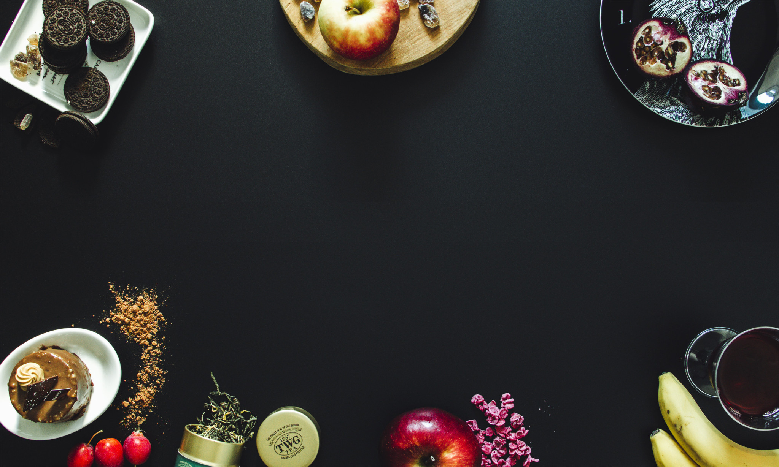


Slide 4
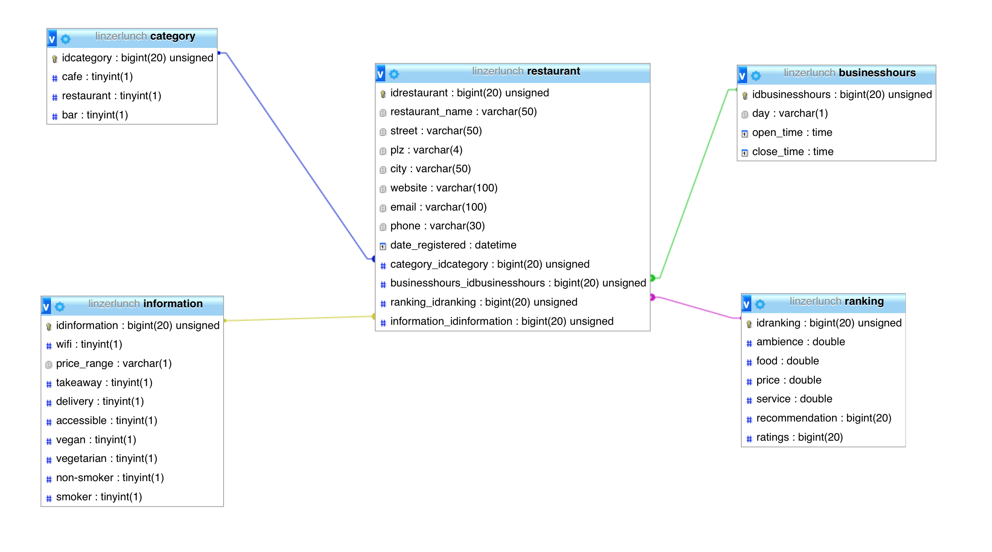

Slide 8



ICON SEARCH

Slide 9
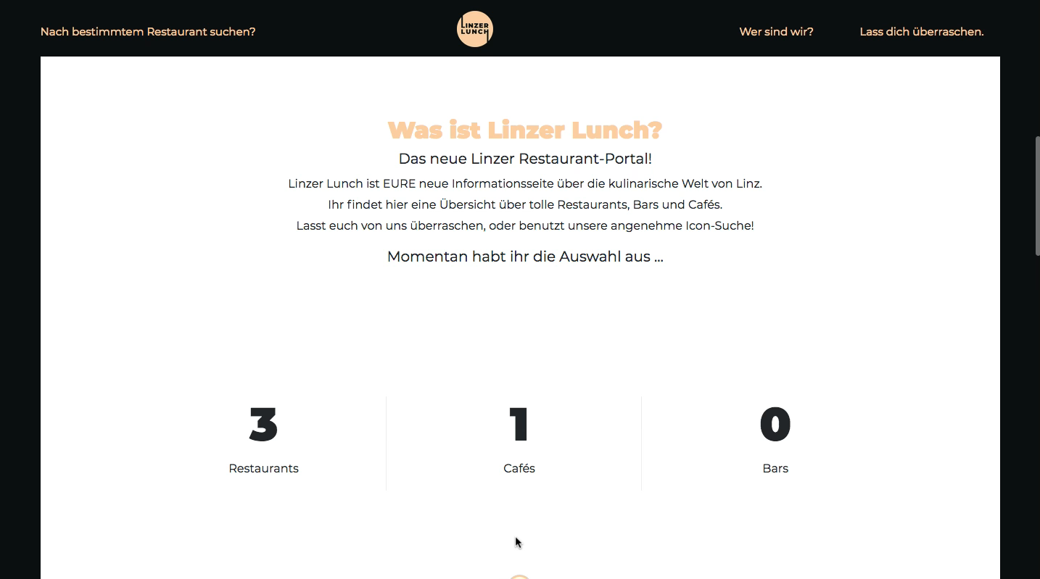
VIDEO?
Für searchButtons

Slide 10
TEXT SEARCH
z.B. Burgerei

Slide 11


Slide 12
RANDOM

Slide 13
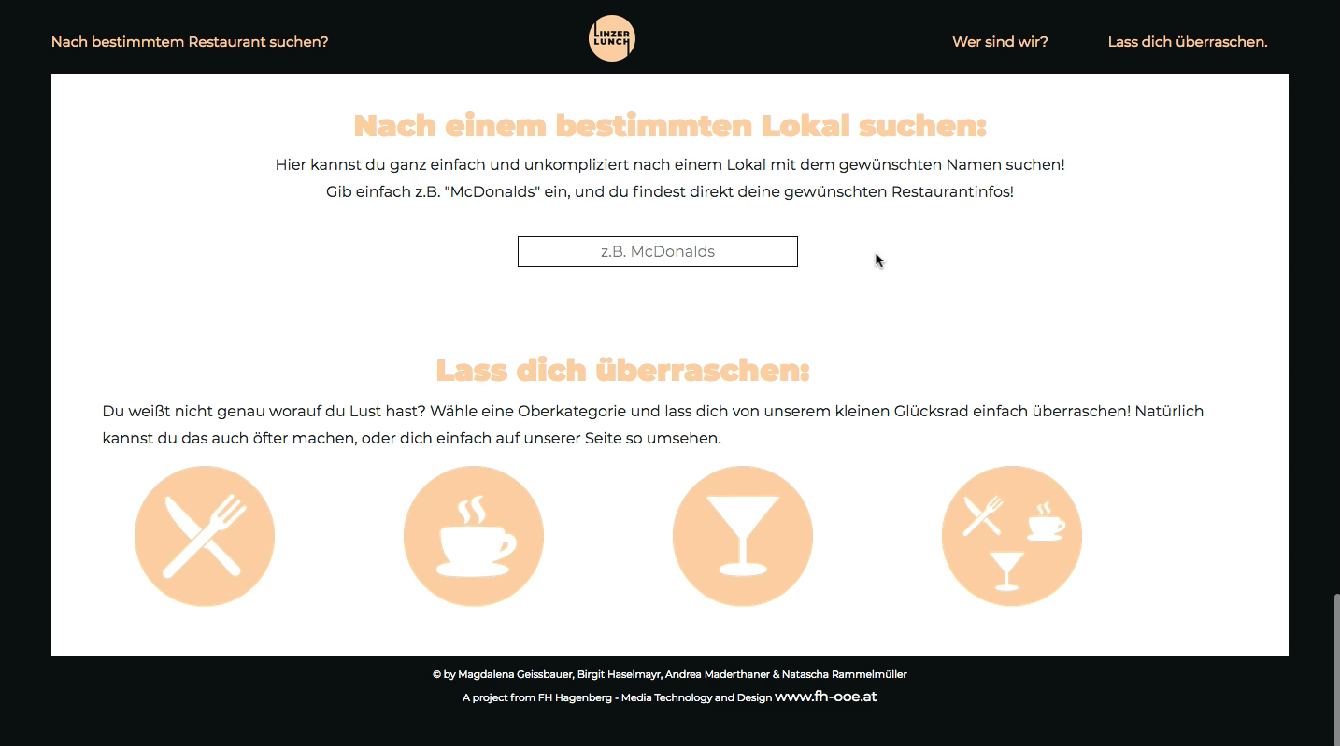

Slide 14
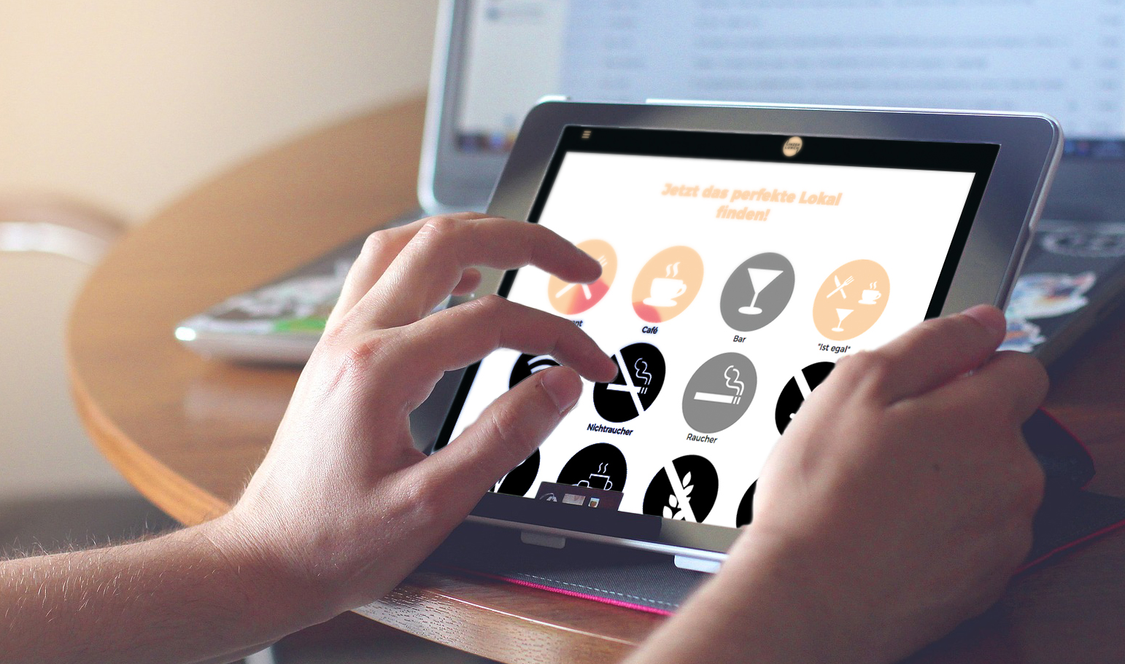
Responsive

Slide 15

Responsive

